Slide 1

STUDENT DETAILS
Name : B Praveen Kumar
SkillsBuild Email ID : 22mc201a05@anurag.edu.in
College Name : Anurag University
College State : Telangana,Hyderabad
Internship Domain : Data Anaytics
Internship Start and End Date : May 5 to July
STUDENT DETAILS

Slide 2


Problem Statement/Project Topic
Doctor Visit Analysis using Python
The problem statement of my project is doctor visit analysis that is based on their age and other factors how many patients are visited a doctor to cure their diseases.
The data consists of income, gender, age, illness, reduced and some other factors.
So in this project I am analyzing how these factors affects the patients and is they have benefited by visiting the doctor and some other queries.

Slide 3
Agenda
The main agenda of this project is to analyze the dataset which contains the health status of different people.so based on this the following data.
Load the Dataset and display first 15 rows.
Total number of people based on the count of illness.
Visualize and analyze maximum and minimum income.
Correlation between different variables.
Number of males and females affected by the illness

Slide 4
Project Overview
Load the data set as “df=pd.read_csv('DoctorVisit.csv’)”
Shape of the data set is defined as “df.shape”.
Information of the data set is defined as “df.info()”.
The purpose of the project is to identify which age people are mostly affected by illness and which gender people either male or female who are more affecting by the factors which are prescribed above.
So in this project I analyzed how the income of the project affected by visiting the hospital.
plt.figure(figsize=(10,10))
plt.scatter(x='income',y='visits',data=df)
plt.xlabel('income’)
plt.ylabel('visits')

Slide 5
Who are the End Users
The end users of this project are the normal people that they know how their lifestyle is damaged by their health.
As we seen in the project that how the income of the patients should be damaged based on their illness and regular visits of doctor.
By seeing this project I hope that some of the people may know about the importance of their health and by this way the normal people are benefitted by this project.
it is important for healthcare professionals to embrace data science and leverage its power to drive innovation and progress.

Slide 6
SOLUTION AND IT'S VALUE
As we seen the project there are some problems regarding their health issues and their illness. So based on the problems which are identified from the project I should suggest some solutions to them.
The main solution is every individual should know about the importance of their health and also how the health problems will effect their lifestyle.
As observed in the project females are mostly affected by illness so they should take more care.

Slide 7
CUSTOMIZE THE PROJECT
I customize my project as one of the innovative creation which was done by me and it was helpful to others.
Normally we don’t found these type of data that is which was completely analyzed and identified the problems so based on these results the people’s mind set should change.
In this project I use some creative methods like representing the data in bar graphs, visualizing the data with histograms and scatterplots which are some new innovative creations and it may be unique.

Slide 8
MODELLING
Python Libraries & Frameworks:
NumPy Library :
NumPy is a Python library used for Working with Arrays. It also has functions for working in domain of Linear Algebra, Fourier Transform, and Matrices.
Pandas Library :
Pandas is a Python library used for Working with data sets. It has functions for Analyzing, Cleaning, Exploring, and Manipulating data.
Matplotlib Library :
Matplotlib Library is a High Level Graph Plotting library in python that serves as a Visualization utility.

Slide 9
Exploratory Data Analysis
Correlation Analysis
Explore the relationship between different variables in the data using correlation analysis.
1
2
3
Data Distribution
Statistical Insights
Visualize data to understand the distribution of variables in the data set.
Generate statistical summaries, such as descriptive statistics and hypothesis testing, to draw conclusions about the data.

Slide 10
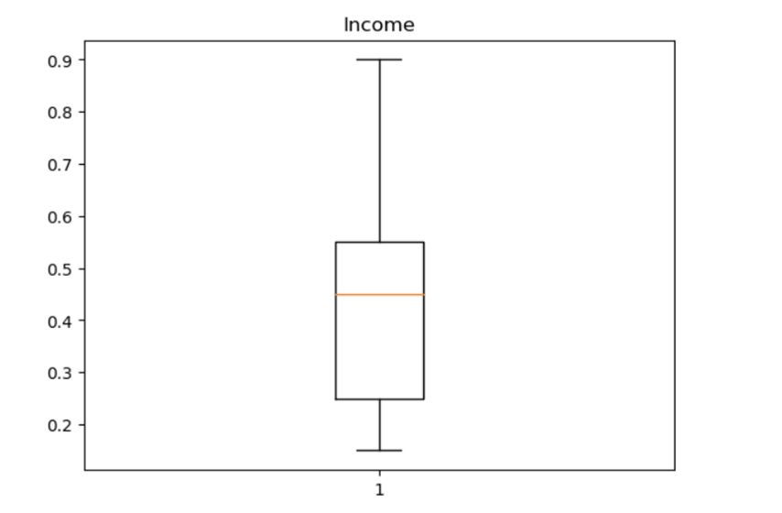
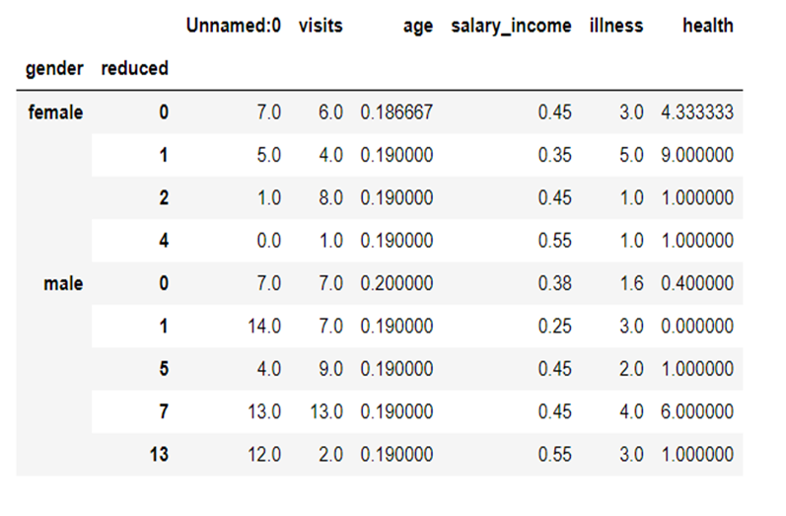
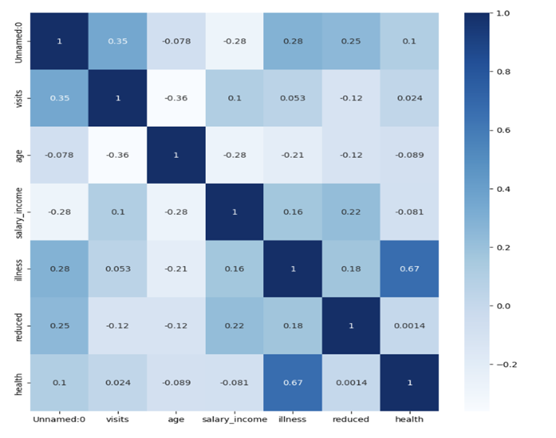
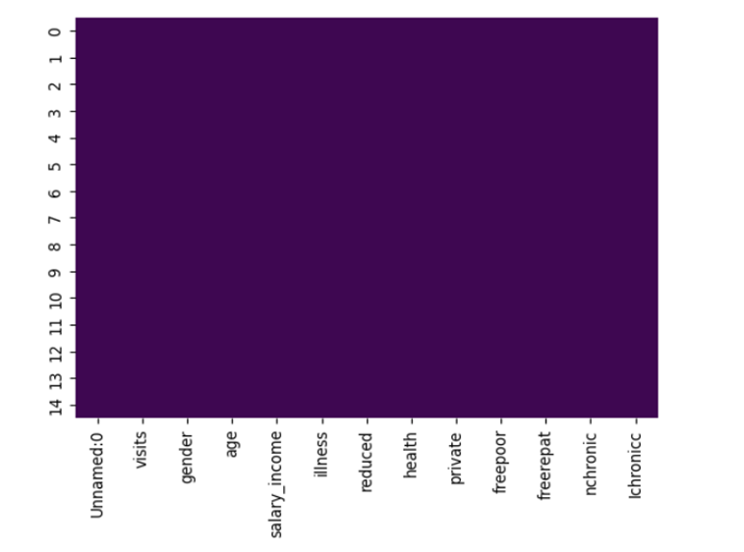
PROJECT OUTPUTS / RESULTS
.

Slide 11
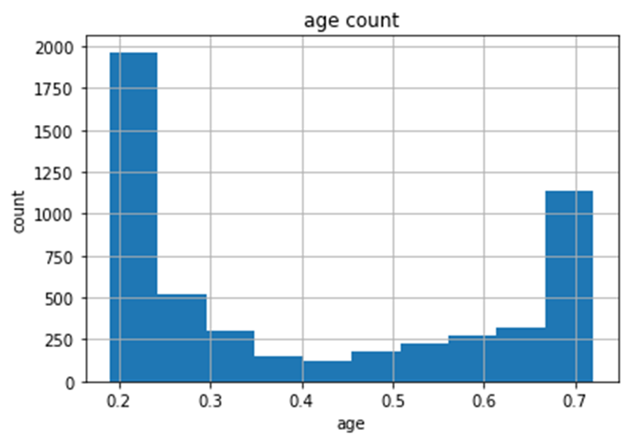
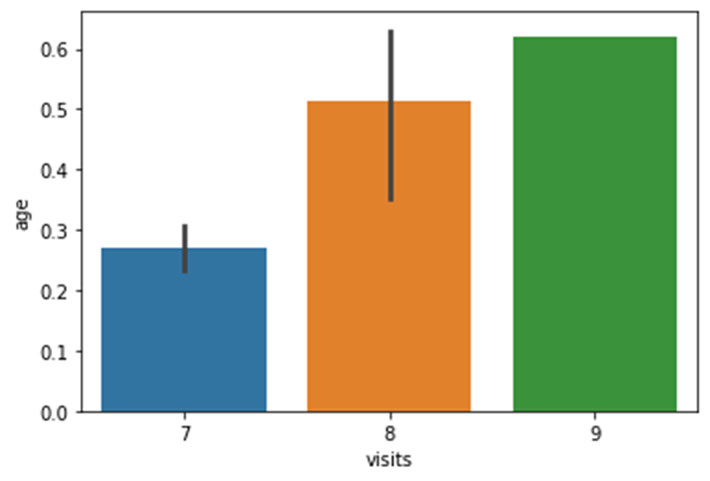
PROJECT OUTPUTS / RESULTS

Slide 12
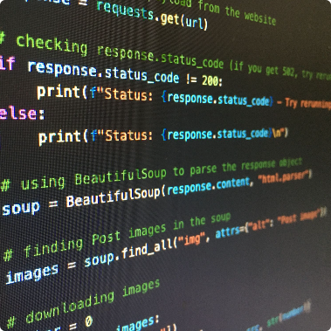
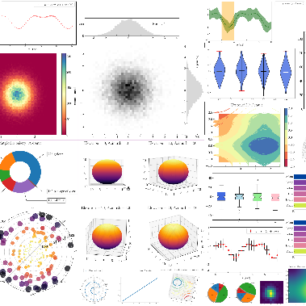
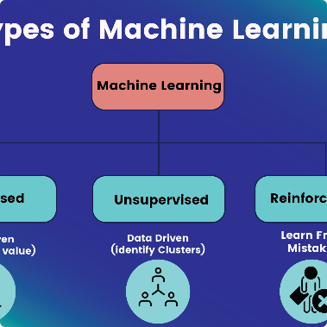
Applying Python for Data Analysis
Data Manipulation
Data Visualization
Machine Learning
Use Pandas library to manipulate datasets, including filtering, grouping, and merging data.
Generate data visualizations using Matplotlib for further data exploration.
Apply machine learning algorithms on the data to discover hidden insights and trends.

Slide 13
PROJECT LINKS
Github Link:
https://github.com/bpraveen5/Doctor-visit-analysisi-using-python.git

Slide 14
Conclusion and Next Steps
1
Conclusions
In Conclusion, we have learned that Data Science is a vital field that can provide valuable insights and inform important decisions. By understanding the fundamentals of data collection, preparation, analysis, and visualization, we can unlock the full potential of Data and use it to Drive Innovation and progress.
2
Next Steps
The analysis can be expanded to more comprehensive data sets, and machine learning algorithms can be refined to increase accuracy.

Slide 15

Thank you
Thank you for joining me on this journey of uncovering insights through doctor visit analysis using Python.

